Slide 1
Big Mountain Ski Resort Ticket Price Recommendation
Lethuy Tran

Slide 2
Problem Identification
Has Big Mountain Ski Resort maximized its returns, relative to its position in the market?
What facilities or properties matter most to the visitors or may be used to boost the ticket price?
What model may be used to provide guidance for Big Mountain’s pricing and future facility investment plans?
If Big Mountain is going to install an additional chair lift, then what is the increased ticket price does it support?

Slide 3
Recommendation and Key Findings
The current ticket price of $81 per adult ticket does not maximize the Big Mountain Ski Resort’s returns
The facilities and properties of Big Mountain Ski Resort could support the ticket price up to $95.87
If Big Mountain is going to install an additional chair lift, it may support an increase of $1.99 per ticket price
FastQuads, Runs, Snow Making_ac, vertical drop, and Skiable Terrain_ac are amongst the most important features

Slide 4
Recommendation and Key Findings (cont.)
Closing one run makes no difference, closing 2 and 3 successively reduces support for ticket price and so revenue.
If 3 runs are closed, then we may close 4 or 5 runs without further loss in ticket price.
Closing down to 6 runs or more leads to a large drop in support for ticket price and revenue
Small increase in the snow making area makes no difference
Increasing the longest run by 0.2 miles and guaranteeing its snow coverage by adding 4 acres of snow making capacity make no difference in ticket price support and revenue

Slide 5
Modeling Results and Analysis
Random Forest Model:
Imputes missing values with strategy of ‘median’
Scales the data with standard scaler
Select the k best features
Train and test model
Use 5-fold cross-validation for estimating model performance
The assessment of the result model has over 60% of the variance and cross-validation shows that assessing model performance is open to variability
The model performs better, has a lower cross-validation mean absolute error, and exhibits less variability than a Linear Regression Model

Slide 6
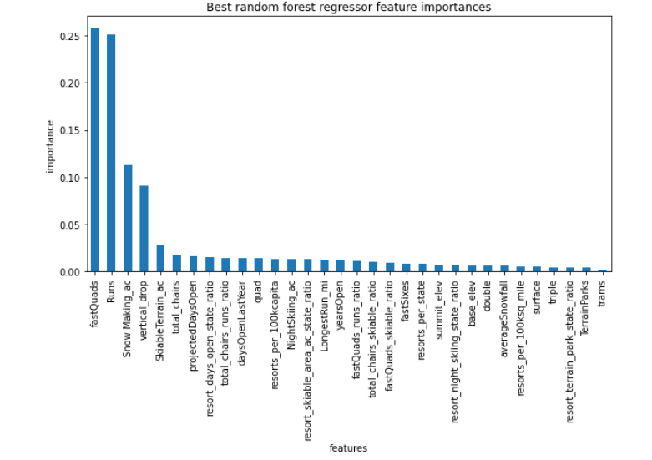
Modeling Results and Analysis (cont.)
Random Forest's feature importances

Slide 7
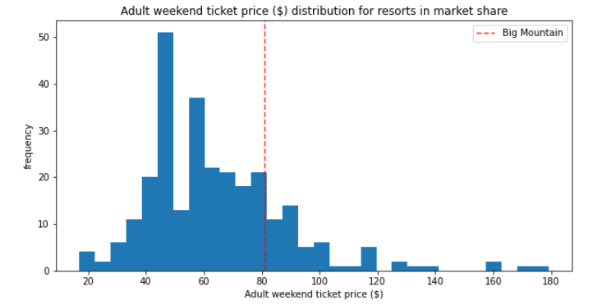
Modeling Results and Analysis (cont.)

Slide 8
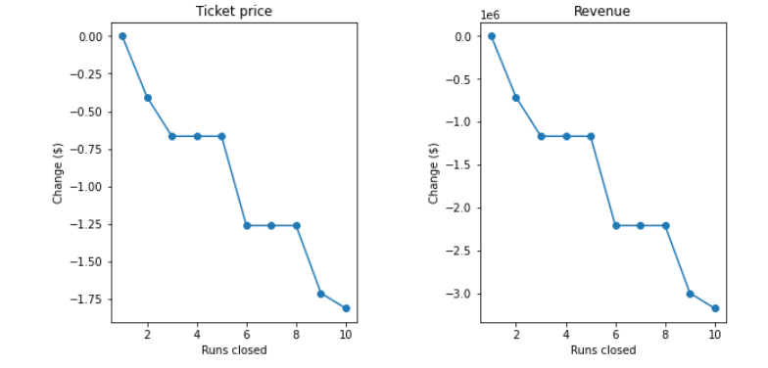
Modeling Results and Analysis (cont.)
Changes in support of ticket price and revenue varying with number of runs to be closed

Slide 9
Summary and Conclusion
A Random Forest Regressor model has been built and trained with data from all other resorts to predict the price for Big Mountain Ski Resort
FastQuads, Runs, Snow Making_ac, vertical drop, and Skiable Terrain_ac are amongst the most important features of the model
Based on the result obtained from the model, the $81 Big Mountain Ski Resort’s ticket price might be undercharging
Big Mountain Ski Resort may increase its ticket price to $95.87 and up to $97.86 if there is going to be an additional chair lift installed at the resort

